Slide 1
CGT620 Final Project
Cloth Simulation
Check Point 1
Jichun Zheng

Slide 2


Slide 3
Mass- Spring Model
For each mass particle on the cloth we have:
M - Mass of Vertex X initial - Initial Length of Spring
g - Gravitational Vector X change - current length of Spring
K - Spring Constant F air resist - (- a) *v *v
F wind - Vector of Wind Speed and Direction

Slide 4
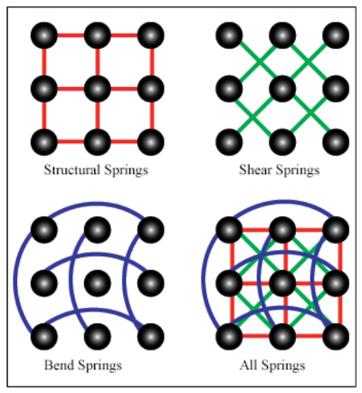
Spring Structure
Structural Spring: handle extension and compression
Shear Spring: handle shear stress, prevent cloth immediately falls into a line
Bend Spring: Connecting every other particle vertically and horizontally

Slide 5
Explicit Integrator
4th order Runge Kutta (RK4)
K1 = h * f(xt, yt); K3 = h * f(xt + h/2, yt + K2*(1/2));
K2 = h * f(xt + h/2, yt + K1*(1/2)); K4 = h * f(xt + h, yt + K3);
y(t+1) = yt + (K1)/6 + (K2)/3 + (K3)/3 + (K4)/6;
Verlet Algorithm:
P(t + h) = 2* P(t) - P(t -h) + (dv/dt) h*h;

